Slide 1
Shell Scripting

Slide 2
What is a shell?
The user interface to the operating system
Functionality:
Execute other programs
Manage files
Manage processes
Full programming language
A program like any other
This is why there are so many shells

Slide 3
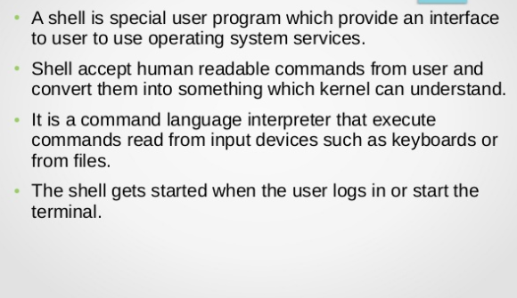

Slide 4
Most Commonly Used Shells
/bin/csh C shell
/bin/tcsh Enhanced C Shell
/bin/sh The Bourne Shell / POSIX shell
/bin/ksh Korn shell
/bin/bash Korn shell clone, from GNU

Slide 5
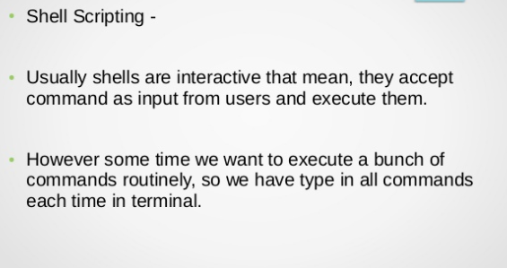

Slide 6
The shell is, after all, a real programming language, complete with variables, control structures, and so forth.
No matter how complicated a script gets, it is still just a list of commands executed sequentially.

Slide 7

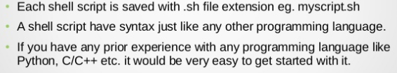

Slide 8
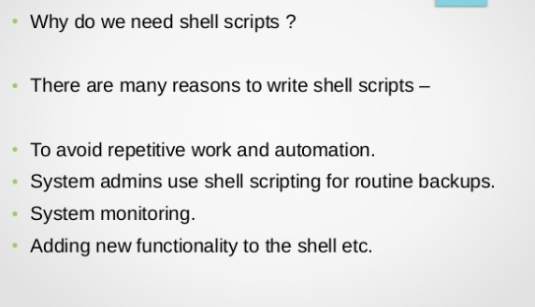

Slide 9
Shell Scripts
A shell script is a regular text file that contains shell or commands
Before running it, it must have execute permission:
chmod +x filename
A script can be invoked as:
./filename.sh

Slide 10
Shell Scripts
When a script is run, the kernel determines which shell it is written for by examining the first line of the script
If 1st line starts with #!pathname-of-shell, then it invokes pathname and sends the script as an argument to be interpreted
If #! is not specified, uses default shell
If a shebang is not specified the script will be parsed by whatever the default interpreter is used by that Shell. For example, the default interpreter for bash is bash and for zsh is sh.
The sequence of characters (#!) is called shebang and is used to tell the operating system which interpreter to use to parse the rest of the file.
Shebang Interpreter Directive

Slide 11
Simple Example
#!/bin/bash echo Hello World

Slide 12
Scripting vs. C Programming
Advantages of shell scripts
Easy to work with other programs
Easy to work with files
Easy to work with strings
Disadvantages of shell scripts
Slower
Not well suited for data structures

Slide 13
echo prints the rest of the line to the screen (standard output).

Slide 14
A variable is a character string to which we assign a value. The value assigned could be a number, text, filename, device, or any other type of data.

Slide 15
Variable Names
The name of a variable can contain only letters (a to z or A to Z), numbers ( 0 to 9) or the underscore character ( _).
By convention, Unix shell variables will have their names in UPPERCASE.
The following examples are valid variable names −
_ALI
TOKEN_A
VAR_1
VAR_2

Slide 16
Following are the examples of invalid variable names −
2_VAR
-VARIABLE
VAR1-VAR2
VAR_A!
The reason you cannot use other characters such as !, *, or - is that these characters have a special meaning for the shell.

Slide 17
Defining Variables
Variables are defined as follows −
variable_name=variable_value
For example −
NAME=“Amity Class"
The above example defines the variable NAME and assigns the value “Amity Class" to it. Variables of this type are called scalar variables. A scalar variable can hold only one value at a time.
Shell enables you to store any value you want in a variable. For example −
VAR1=“Amity Class"
VAR2=100

Slide 18
Accessing Values
To access the value stored in a variable, prefix its name with the dollar sign ($)
For example, the following script will access the value of defined variable NAME and print it on STDOUT −
#!/bin/bash
NAME=“Amity Class"
echo $NAME
The above script will produce the following value −
Amity Class

Slide 19
Read-only Variables
Shell provides a way to mark variables as read-only by using the read-only command.
After a variable is marked read-only, its value cannot be changed.
For example, the following script generates an error while trying to change the value of NAME −
NAME=“Amity Class"
readonly NAME
NAME=“AI Class"
The above script will generate error

Slide 20
Shell Variables
The value of a variable can be returned/used by adding a prefix $
Linux shell scripting are using two types of variables : System Defined Variables & User Defined Variables
a shell script doesn’t require you to declare a type for your variables
The value of a variable can be returned/used by adding a prefix $

Slide 21
To set:
name=value
To Read: $var

Slide 22
Variable Example
#!/bin/bash MESSAGE="Hello World" echo $MESSAGE

Slide 23
You can accept input from the keyboard and assign an input value to a user defined shell variable using read command.
The following script uses he read command which takes the input from the keyboard and assigns it as the value of the variable PERSON and finally prints it on STDOUT.
echo "What is your name?"
read PERSON
echo "Hello, $PERSON"

Slide 24
read multiple variables
read a b c
read -p "Prompt" variable1 variable2
Where,
-p "Prompt" : Display prompt to user without a newline.
variable1 : The first input (word) is assigned to the variable1.
variable2 : The second input (word) is assigned to the variable2.

Slide 25
Example
#! /bin/bash
read -p "Enter your name : " name
"Hi, $name. Let us be friends!"
Save and close the file. Run it as follows:
chmod +x filename.sh
./filename.sh

Slide 26
Example
#!/bin/bash
# read three numbers and assigned them to 3 vars
read -p "Enter number one : " n1
read -p "Enter number two : " n2
read -p "Enter number three : " n3
# display back 3 numbers - punched by user.
echo "Number1 - $n1"
echo "Number2 - $n2"
echo "Number3 - $n3"

Slide 27
Handling Passwords
The -s option causes input coming from a terminal do not be displayed on the screen.
#!/bin/bash
read -s -p "Enter Password : " my_password
echo
echo "Your password - $my_password"

Slide 28
Environmental Variables
NAME MEANING
$HOME Absolute pathname of your home directory
$PATH A list of directories to search for
$USER Your login name
$SHELL Absolute pathname of login shell
$TERM Type of your terminal
$PS1 Prompt

Slide 29
To group several strings together as one argument it is necessary to use double quotes: “
For example:
v=Hello World
echo $v
Hello
v="Hello World"
echo $v
Hello World

Slide 30
Command Substitution
Used to turn the output of a command into a string
Used to create arguments or variables
Command is placed with backquote` ` to capture the output of command
$ date Wed Sep 25 14:40:56 EDT 2001 $ NOW=`date`

Slide 31
Operators
Arithmetic Operators
Relational Operators
Boolean Operators
String Operators
File Test Operators

Slide 32
Arithmetic
shell didn't originally have any mechanism to perform simple arithmetic operations but it uses external programs
Use external command /bin/expr
expr expression
Evaluates expression and sends the result to standard output.
expr 4 + 3 (space around operator)
expr 4 "*" 12

Slide 33
Particularly useful with command substitution X=`expr $X + 2`
Example
#!/bin/bash
val=`expr 2 + 2`
echo "Total value : $val"

Slide 34
The following points need to be considered while using expr −
There must be spaces between operators and expressions. For example, 2+2 is not correct; it should be written as 2 + 2.
The complete expression should be enclosed between ‘ ‘, called the backquote

Slide 35
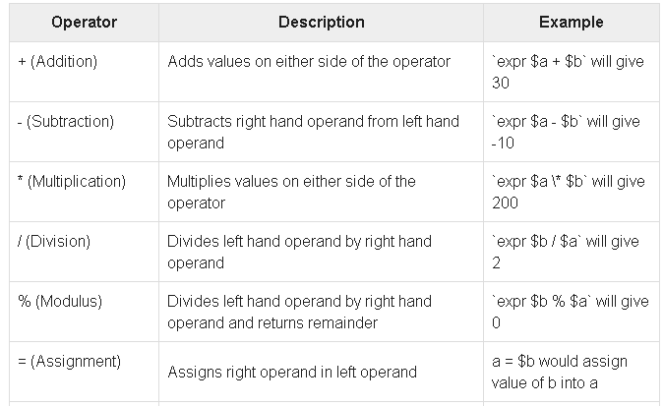
Arith
Assume variable a holds 10 and variable b holds 20 then

Slide 36
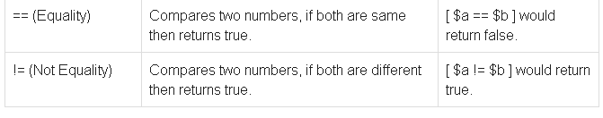
It is very important to understand that all the conditional expressions should be inside square braces with spaces around them, for example [ $a == $b ] is correct whereas, [$a==$b] is incorrect.
All the arithmetical calculations are done using long integers.

Slide 37
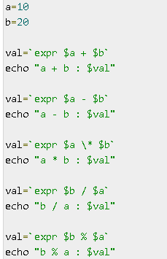

Slide 38
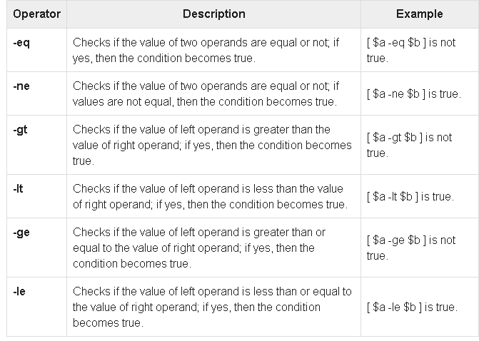
Relational Operators
Assume variable a holds 10 and variable b holds 20 then

Slide 39
It is very important to understand that all the conditional expressions should be placed inside square braces with spaces around them

